Slide 1
Outline
Qwerty-Bounded Keyboard Layout Optimization
Multilingual Keyboard Layout Optimization
Keyboard Layout Optimization for Gesture Typing
Multi-Objective Optimization for Decoding Algorithm
[Smith, Bi, and Zhai. Optimizing Touchscreen Keyboards for Gesture Typing. ACM CHI2015]

Slide 2
Gesture Typing
Notes:
So first of all, for those less familiar, what is gesture typing?

Slide 3
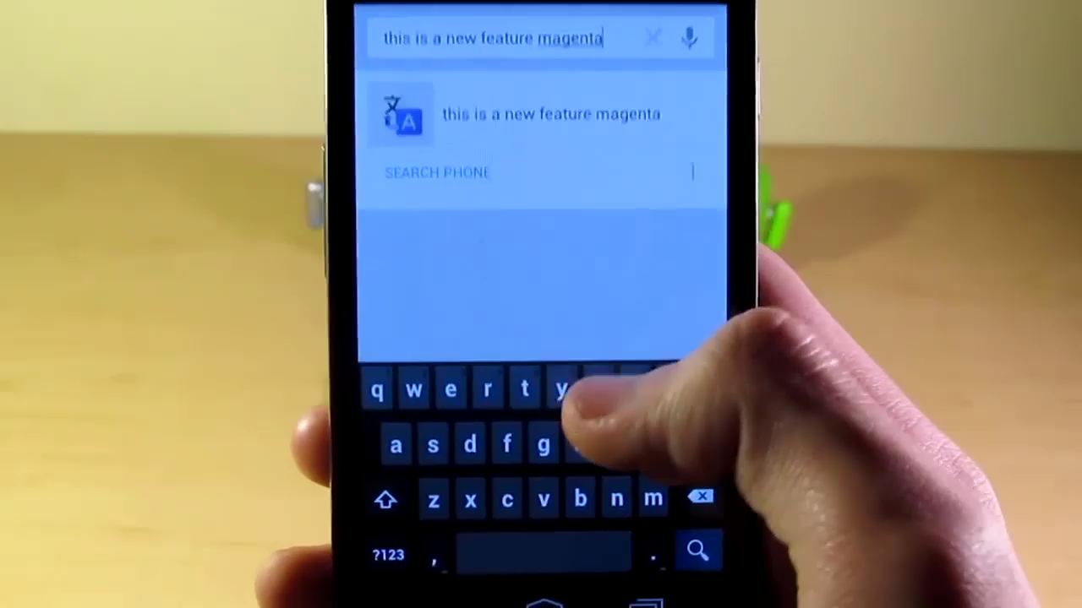
Gesture Typing: Overview
Gesture Typing:
Typing words by swiping through their letters
https://www.youtube.com/watch?v=BkjiMpN9hvA
Notes:
It’s the idea of typing words on a touchscreen keyboard by swiping through their letters —with strokes instead of taps. Unlike touch typing, you don’t have to type spaces, so that’s 1/6 of all characters that you save. And your finger doesn’t have to travel as much since you don’t need to lift it between letters.
It’s also called shape writing or a word gesture keyboard.

Slide 4
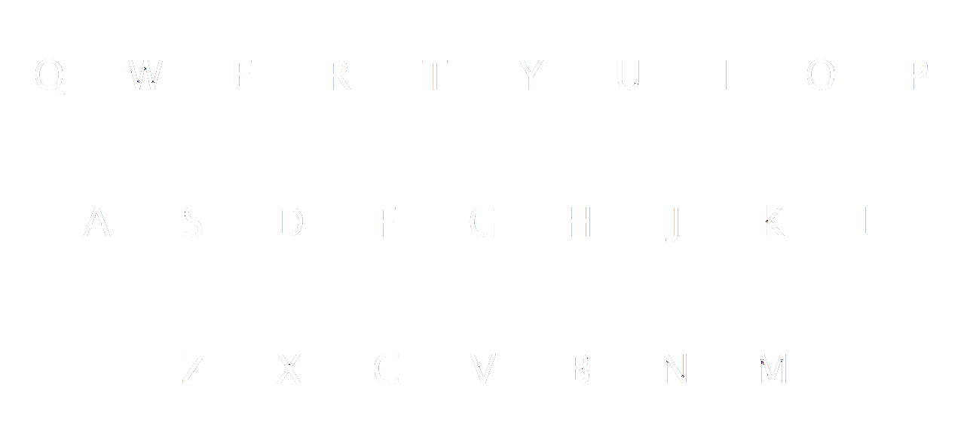
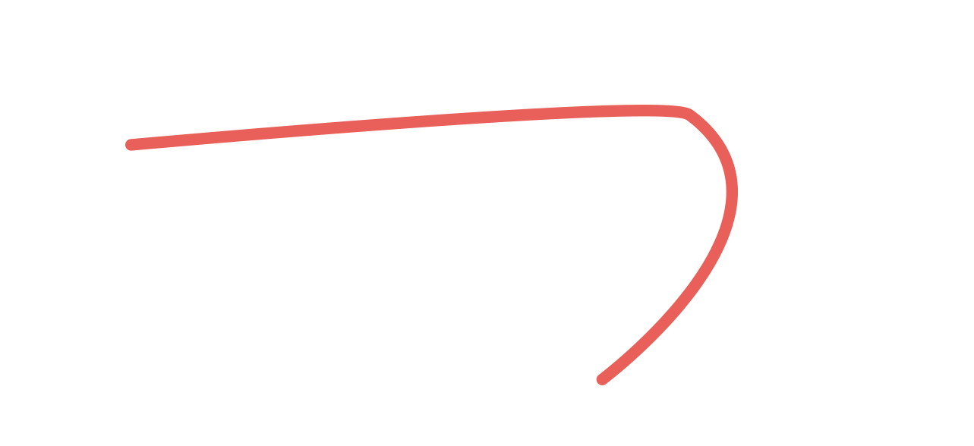
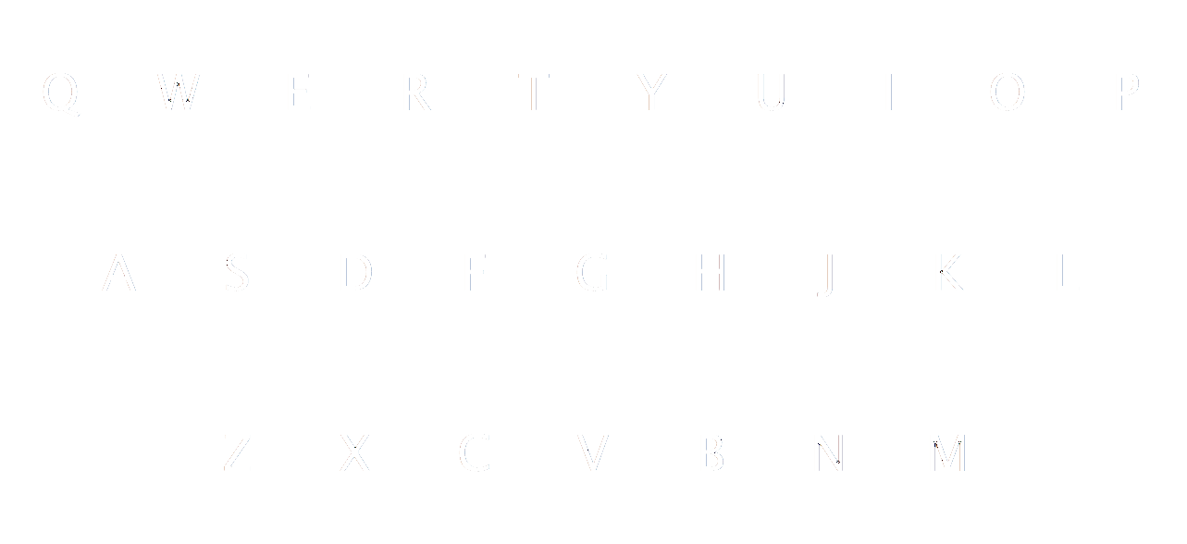
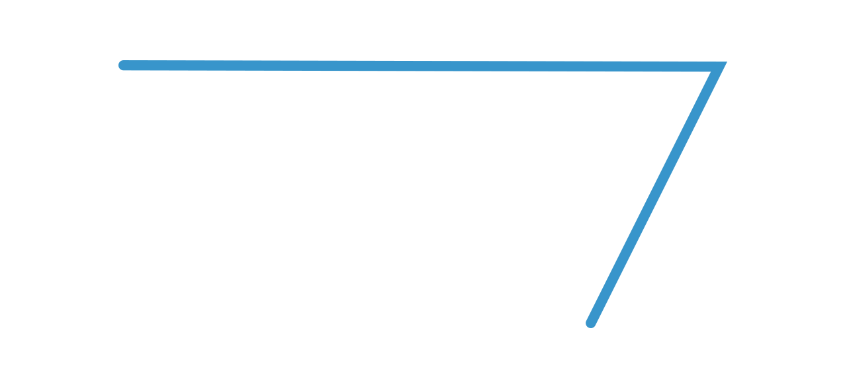
Proportional Shape Matching
Notes:
The gestures that you type are recognized in part by a process called proportional shape matching. Suppose you’d like to type the word “won,” which looks like this, but the gesture you actually make looks like this. To find the similarity between your gesture g and the ideal trace T, the system samples both curves into N equidistant points, then finds the average distance between corresponding points. The offset matters because you might have intended to type different letters.
Hopefully, “won” is the closest word to that gesture you made — otherwise you’ll get an error. That error points to the key disadvantage of gesture typing over touch typing: gesture ambiguity.

Slide 5
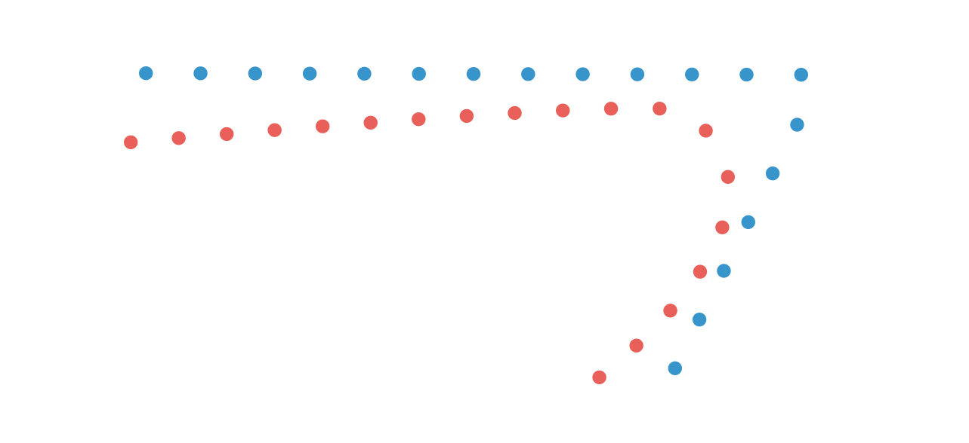
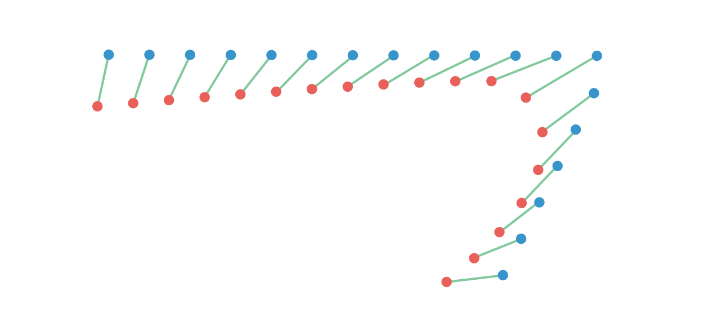
Proportional Shape Matching
Notes:
The gestures that you type are recognized in part by a process called proportional shape matching. Suppose you’d like to type the word “won,” which looks like this, but the gesture you actually make looks like this. To find the similarity between your gesture g and the ideal trace T, the system samples both curves into N equidistant points, then finds the average distance between corresponding points. The offset matters because you might have intended to type different letters.
Hopefully, “won” is the word that comes up — otherwise you’ll fall victim to the key disadvantage of gesture typing over touch typing: gesture ambiguity.

Slide 6
Key Disadvantage:
Gesture Ambiguity

Slide 7
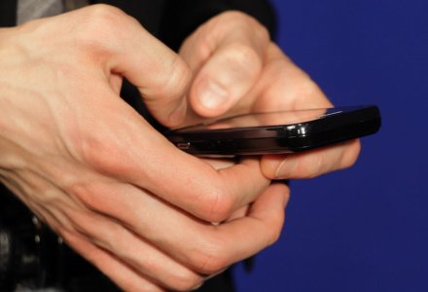
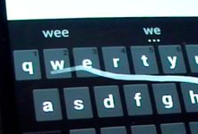
Sources of Error
Method | Sources of Error
Touch Typing
Gesture Typing
Sloppy User Input
Sloppy User Input
Gesture Ambiguity
Notes:
What do I mean by that? With touch typing, the only real source of error that you have is sloppy input from the user (he or she doesn’t tap in the right place).
With gesture typing, you still have to worry about this —sloppy gestures— but you also have to worry about the word gestures themselves being hard to differentiate between, even if they’re typed perfectly.
And to show you what I mean by that, I’ll let you play the role of the gesture decoder to see how hard it really is. It’s time for a pop quiz.

Slide 8
Pop Quiz
Notes:
The ball’s in your court. Here’s how it’s going to work. I’m going to show you two words, and your job is to say whether they have distinct gestures (which is good) or identical gestures (which is bad).

Slide 9
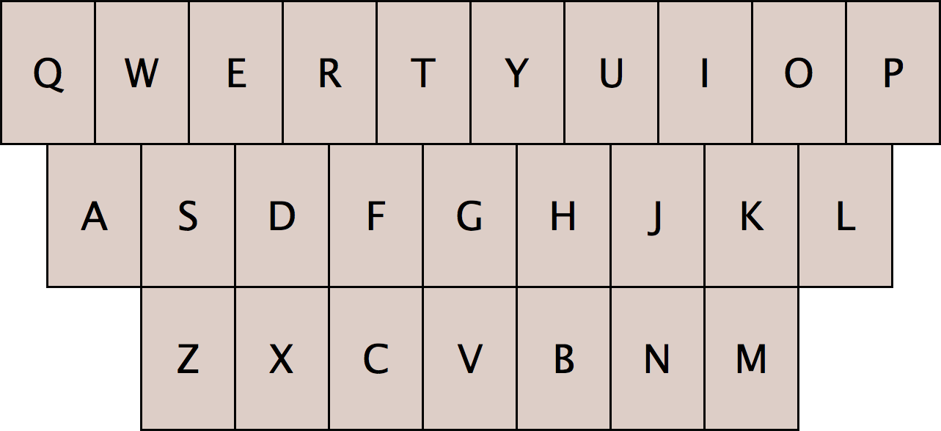
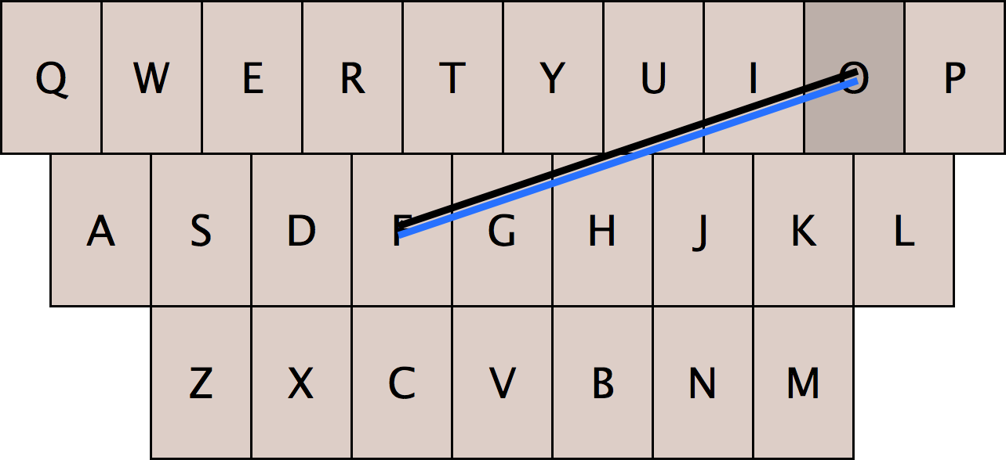
Question 1
of off
Answer:
SAME

Slide 10
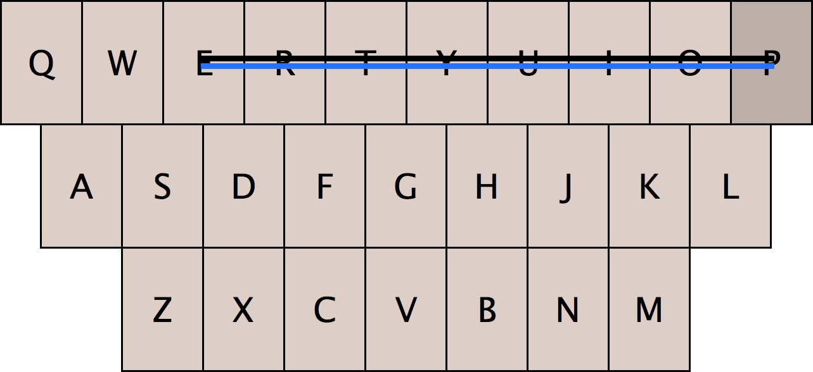
Question 2
pretty prey
Answer:
SAME

Slide 11
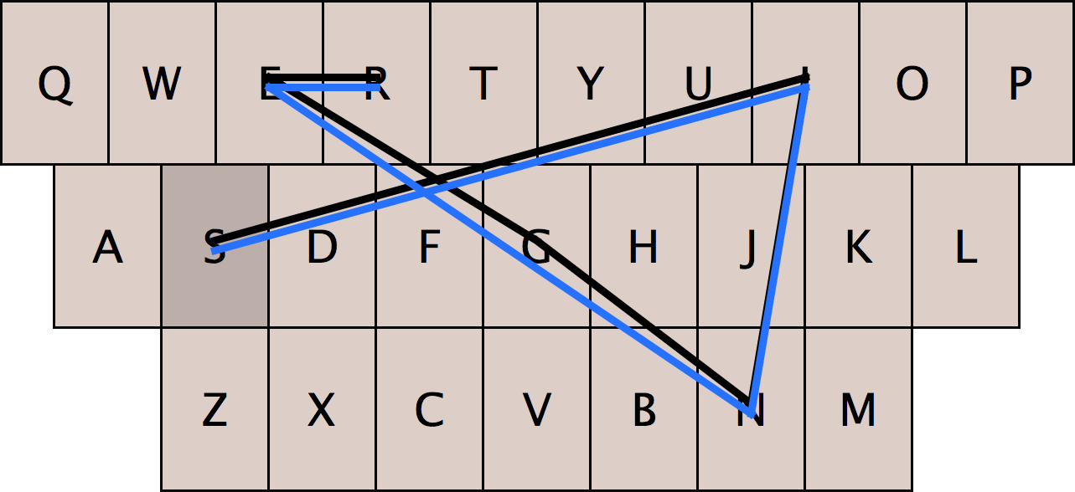
Question 3
singer sinner
Answer:
DIFFERENT

Slide 12
Gesture Ambiguity
Notes:
Clearly, gesture ambiguity is a big problem. But If you look at current gesture typing systems, and see what they do to rectify this problem, they use what’s called a language model to predict what you’re typing based on the frequencies of word sequences.
But a language model isn’t enough. Here’s why.

Slide 13
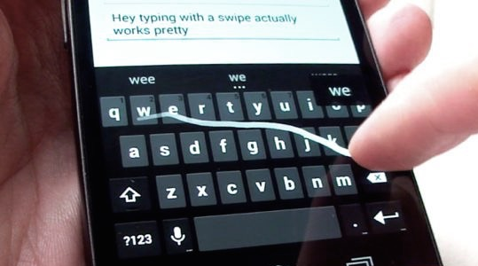
Language Model
wee
22%
actually
works
pretty
well
31%
we
16%
Notes:
Clearly, gesture ambiguity is a big problem. But If you look at current gesture typing systems, and see what they do to rectify this problem, they use what’s called a language model to predict what you’re typing based on the frequencies of word sequences.
But a language model isn’t enough. Here’s why.

Slide 14
Types of Ambiguity
Type | Examples | % of Words
 |  | by Count | by Frequency
Identical (Unavoidable) | of off | 4.1% | 22.2%
Identical (Avoidable) | pretty prey | 2.3% | 5.7%
Similar (Avoidable) | singer sinner | 77.8% | 69.0%
Question 1
of off
of off
Notes:
It turns out that there are three types of ambiguous word gestures that we discovered. The first type includes words such as “of” and “off” that we saw before. With these words, the ambiguity is unavoidable because there’s no way to gesture a letter twice, unlike tapping. So we call this type Unavoidable. In our corpus of 40,000 words, 4.1% of words by count and 22.2% of words by frequency have another word with an unavoidably identical gesture.
Then there are words like “pretty” and “prey,” which we call Avoidable. These are different because the only reason they’re ambiguous is that the ‘t’ is located right between the ‘e’ and the ‘y’. In other words, that gestures crosses unintended letters on the way to the intended one. So it seems that most of the ambiguity that we have is just plain unavoidable.
But the biggest news comes from words like “singer” and “sinner.” Here’s where the situation changes. These are what I call similar gestures: not completely identical but still very close to each other—less than one key width on average. A whopping 69% of words by frequency have another word with a gesture so similar to its own. That means, if you add up the numbers in the right column and subtract from 100%, that only 3.1% of all words (again, by frequency) has a gesture that’s actually distinct!
By categorizing words this way, we can see two things: (1) that there’s a real potential for improvement beyond just using a language model; and (2) that the improvement is actually possible, since most of the problem is actually avoidable.
So how do we make the word gestures more distinct? We have to change the positions of the letters, which means we have to change the keyboard layout.

Slide 15
Types of Ambiguity
Type | Examples | % of Words
 |  | by Count | by Frequency
Identical (Unavoidable) | of off | 4.1% | 22.2%
Identical (Avoidable) | pretty prey | 2.3% | 5.7%
Similar (Avoidable) | singer sinner | 77.8% | 69.0%
Question 2
pretty prey
pretty prey
Notes:
It turns out that there are three types of ambiguous word gestures that we discovered. The first type includes words such as “of” and “off” that we saw before. With these words, the ambiguity is unavoidable because there’s no way to gesture a letter twice, unlike tapping. So we call this type Unavoidable. In our corpus of 40,000 words, 4.1% of words by count and 22.2% of words by frequency have another word with an unavoidably identical gesture.
Then there are words like “pretty” and “prey,” which we call Avoidable. These are different because the only reason they’re ambiguous is that the ‘t’ is located right between the ‘e’ and the ‘y’. In other words, that gestures crosses unintended letters on the way to the intended one. So it seems that most of the ambiguity that we have is just plain unavoidable.
But the biggest news comes from words like “singer” and “sinner.” Here’s where the situation changes. These are what I call similar gestures: not completely identical but still very close to each other—less than one key width on average. A whopping 69% of words by frequency have another word with a gesture so similar to its own. That means, if you add up the numbers in the right column and subtract from 100%, that only 3.1% of all words (again, by frequency) has a gesture that’s actually distinct!
By categorizing words this way, we can see two things: (1) that there’s a real potential for improvement beyond just using a language model; and (2) that the improvement is actually possible, since most of the problem is actually avoidable.
So how do we make the word gestures more distinct? We have to change the positions of the letters, which means we have to change the keyboard layout.

Slide 16
Types of Ambiguity
Type | Examples | % of Words
 |  | by Count | by Frequency
Identical (Unavoidable) | of off | 4.1% | 22.2%
Identical (Avoidable) | pretty prey | 2.3% | 5.7%
Similar (Avoidable) | singer sinner | 77.8% | 69.0%
Question 3
singer sinner
Notes:
It turns out that there are three types of ambiguous word gestures that we discovered. The first type includes words such as “of” and “off” that we saw before. With these words, the ambiguity is unavoidable because there’s no way to gesture a letter twice, unlike tapping. So we call this type Unavoidable. In our corpus of 40,000 words, 4.1% of words by count and 22.2% of words by frequency have another word with an unavoidably identical gesture.
Then there are words like “pretty” and “prey,” which we call Avoidable. These are different because the only reason they’re ambiguous is that the ‘t’ is located right between the ‘e’ and the ‘y’. In other words, that gestures crosses unintended letters on the way to the intended one. So it seems that most of the ambiguity that we have is just plain unavoidable.
But the biggest news comes from words like “singer” and “sinner.” Here’s where the situation changes. These are what I call similar gestures: not completely identical but still very close to each other—less than one key width on average. A whopping 69% of words by frequency have another word with a gesture so similar to its own. That means, if you add up the numbers in the right column and subtract from 100%, that only 3.1% of all words (again, by frequency) has a gesture that’s actually distinct!
By categorizing words this way, we can see two things: (1) that there’s a real potential for improvement beyond just using a language model; and (2) that the improvement is actually possible, since most of the problem is actually avoidable.

Slide 17
Types of Ambiguity
Type | Examples | % of Words
 |  | by Count | by Frequency
Identical (Unavoidable) | of off | 4.1% | 22.2%
Identical (Avoidable) | pretty prey | 2.3% | 5.7%
Similar (Avoidable) | singer sinner | 77.8% | 69.0%
Only 3.1% of words have distinct gestures!
Notes:
It turns out that there are three types of ambiguous word gestures that we discovered. The first type includes words such as “of” and “off” that we saw before. With these words, the ambiguity is unavoidable because there’s no way to gesture a letter twice, unlike tapping. So we call this type Unavoidable. In our corpus of 40,000 words, 4.1% of words by dictionary count and 22.2% of words by usage frequency have another word with an unavoidably identical gesture.
Then there are words like “pretty” and “prey,” which we call Avoidable. These are different because the only reason they’re ambiguous is that the ‘t’ is located right between the ‘e’ and the ‘y’. In other words, that gestures crosses unintended letters on the way to the intended one. So it seems that most of the ambiguity that we have is just plain unavoidable.
But the biggest news comes from words like “singer” and “sinner.” Here’s where the situation changes. These are what I call similar gestures: not completely identical but still very close to each other—less than one key width on average. A whopping 69% of words by frequency have another word with a gesture so similar to its own. That means, if you add up the numbers in the right column and subtract from 100%, that only 3.1% of all words (again, by frequency) has a gesture that’s actually distinct!
By categorizing words this way, we can see two things: (1) that there’s a real potential for improvement beyond just using a language model; and (2) that the improvement is actually possible, since most of the problem is actually avoidable.
So how do we make the word gestures more distinct? We have to change the positions of the letters, which means we have to change the keyboard layout.

Slide 18
Q. How can we make word gestures more distinct?
A. Change the keyboard layout!
Notes:
So how do we make the word gestures more distinct? We have to change the positions of the letters, which means we have to change the keyboard layout.

Slide 19
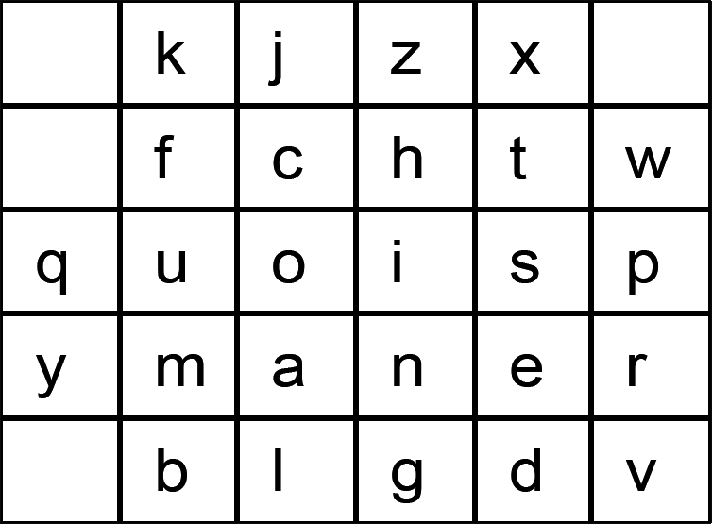
Learnability
Freely Optimized for Speed Source: [Bi et al., 2010]
24% expert speed increase
100% novice speed decrease
Notes:
But changing the keyboard layout creates a lot of problems. First, and foremost, is learnability. The new layout is going to be hard for people to learn, and they’ll have to invest a lot of time just to be moderately proficient with it. As a point of reference, this freely optimized layout by Xiaojun Bi is 24% faster than Qwerty, but it takes twice as long to use at first. And sadly, if you create a compromise layout that balances speed and learnability, that cost–benefit ratio remains the same. Quasi-Qwerty, from the same paper, is optimized for speed but with the constraint that keys can only move one slot from their Qwerty positions. The upfront cost is always much greater than the eventual benefit.
And, speaking of optimized layouts, some of you are probably wondering: aren’t there already optimized layouts out there? That’s the second issue. To that point, the answer is yes — there are a lot of them — but existing layouts are optimized almost exclusively for typing speed, while our problem is gesture clarity, or distinctness, which is different. So if you look at Qwerty, the status quo, it was designed so that you alternate hands a lot when typing, which makes things faster and avoids typewriter jamming. But this means that word gestures go back and forth horizontally, making them very similar to each other. Dvorak optimizes for speed even more by placing common letters on the home row, but now gestures become even more similar because they’re back and forth on the same row. ATOMIK was optimized for stylus tapping speed, but it actually predates gesture typing. Common letters are clumped together and so are their gestures. And finally, the OSKs (or optimized stroke keyboards) was actually optimized for stroking but only for stroking speed, so you still see common letters and tons of gestures clumped together in the middle.

Slide 20
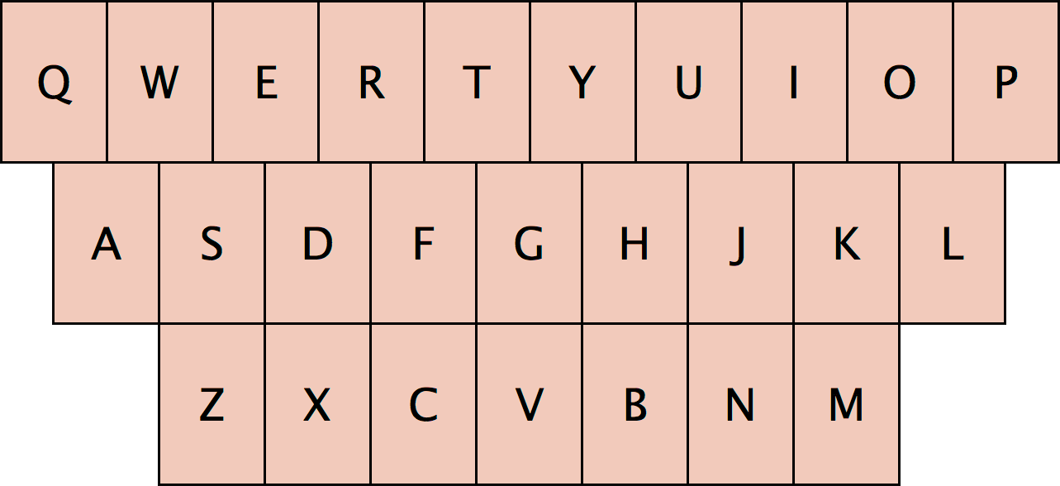
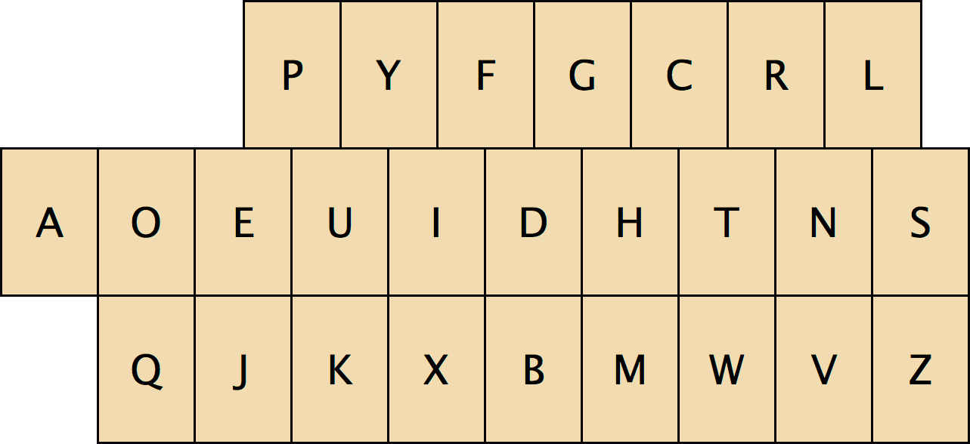
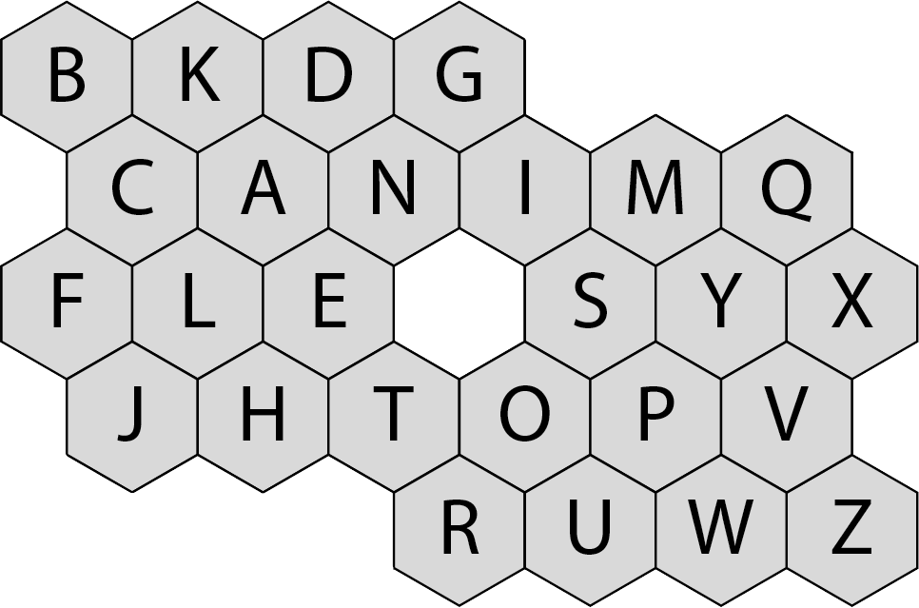
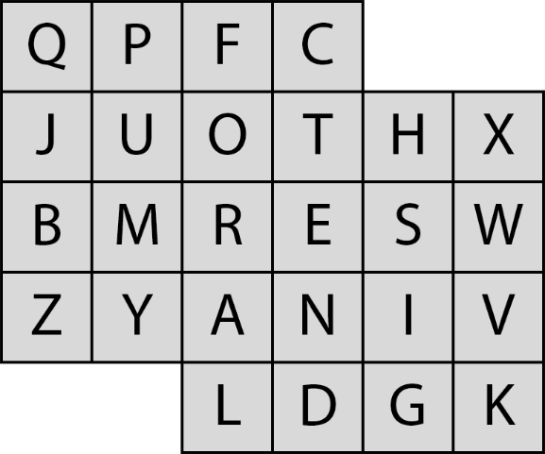
Speed ≠ Clarity
Qwerty
Dvorak
ATOMIK Source: [Zhai, 2002]
Image Source: [Rick, 2010]
Square OSK Source: [Rick, 2010]
Notes:
And, speaking of optimized layouts, some of you are probably wondering: aren’t there already optimized layouts out there? That’s the second issue. To that point, the answer is yes — there are a lot of them — but existing layouts are optimized almost exclusively for typing speed, while our problem is gesture clarity, or distinctness, which is different. So if you look at Qwerty, the status quo, it was designed so that you alternate hands a lot when typing, which makes things faster and avoids typewriter jamming. But this means that word gestures go back and forth horizontally, making them very similar to each other. Dvorak optimizes for speed even more by placing common letters on the home row, but now gestures become even more similar because they’re back and forth on the same row. ATOMIK was optimized for stylus tapping speed, but it actually predates gesture typing. Common letters are clumped together and so are their gestures. And finally, the OSKs (or optimized stroke keyboards) was actually optimized for stroking but only for stroking speed, so you still see common letters and tons of gestures clumped together in the middle.

Slide 21

Key Questions
Must gesture clarity and typing speed necessarily conflict?
How much clearer can gestures get?
How will keeping the layout similar to Qwerty affect our results?
Notes:
But still, that conflict between gesture clarity and typing speed brings to light another series of questions. First of all, are they truly at odds with each other, or is it possible to improve both of them at the same time?
And how much clearer could the gestures get if we optimized for clarity?
And how does this change if we want to make the layout similar to Qwerty, for learnability’s sake?

Slide 22
Optimization Metrics
Notes:
Getting to the bottom of these answers was the goal of this project. To do that, we computationally explored the layout optimization space for gesture typing to see how three different metrics — gesture clarity, typing speed, and Qwerty similarity as a proxy for learnability — interact with each other. Each of these metrics takes a keyboard layout as input, but they output different things.
First, I’ll go through the metrics to show you how they work, and then I’ll show you how we actually did the optimization.

Slide 23
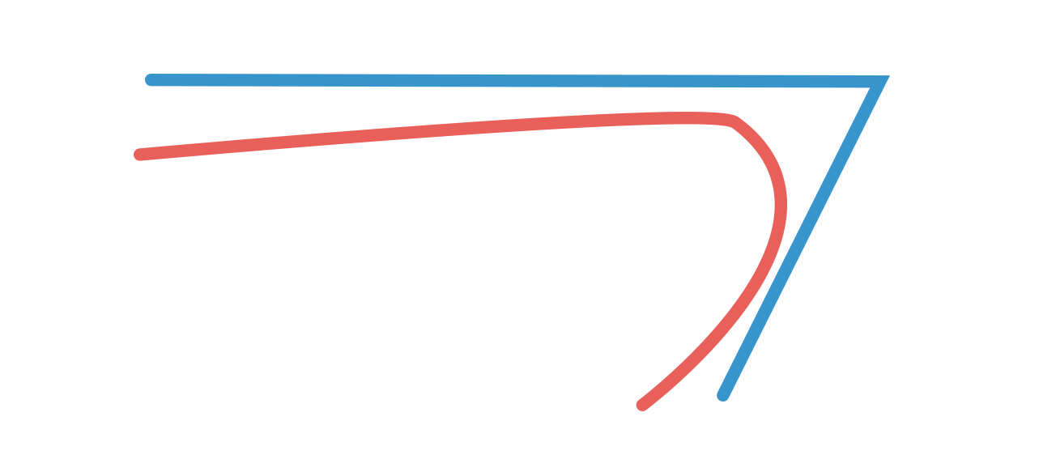
Gesture Clarity Metric
Basis:
Proportional shape matching
Input:
Notes:
The first, and most important, metric is the gesture clarity metric. This is the metric that measures how distinct the word gestures in a given keyboard layout are. It’s based on proportional shape matching, which we saw earlier. Given a keyboard layout as input, it computes word gestures for every word in our lexicon and finds each word’s nearest neighbor. That’s the word that a given word is most likely to be confused with, so we’re hoping the gestures are far apart.
Then, as output, the metric computes the average distance (weighted by words’ frequencies) between each word and its nearest neighbor. The units are key widths. Qwerty’s is just 0.39 key widths.

Slide 24
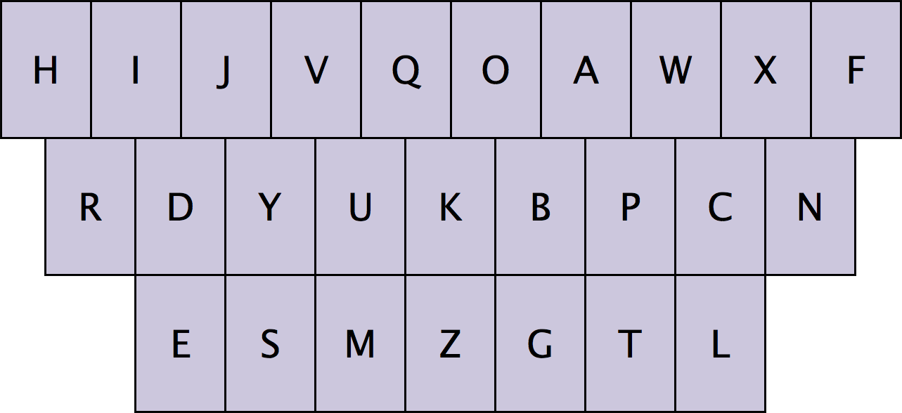
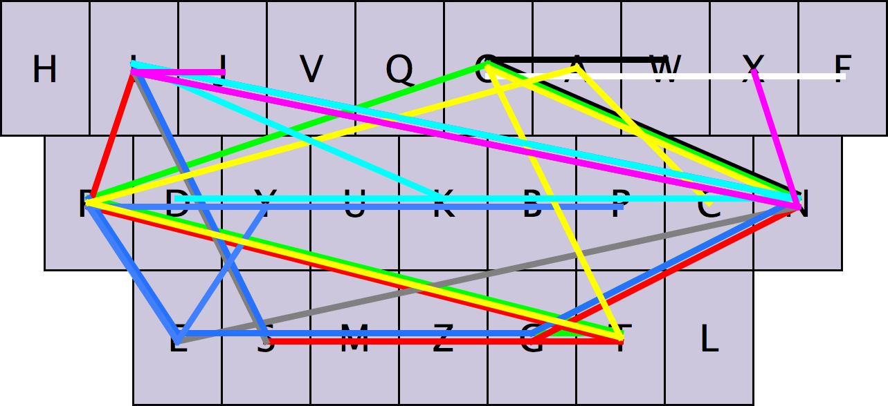
Gesture Clarity Metric
Basis:
Proportional shape matching
Input:
Keyboard layout K
Output:
Average distance between a word and its nearest neighbor on K
Notes:
The first, and most important, metric is the gesture clarity metric. This is the metric that measures how distinct the word gestures in a given keyboard layout are. It’s based on proportional shape matching, which we saw earlier. Given a keyboard layout as input, it computes word gestures for every word in our lexicon and finds each word’s nearest neighbor. That’s the word that a given word is most likely to be confused with, so we’re hoping the gestures are far apart.
Then, as output, the metric computes the average distance (weighted by words’ frequencies) between each word and its nearest neighbor. The units are key widths. Qwerty’s is just 0.39 key widths.

Slide 25


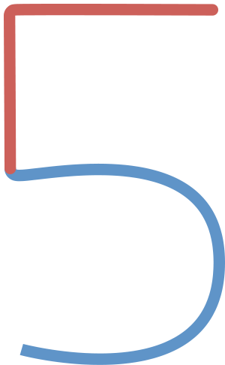
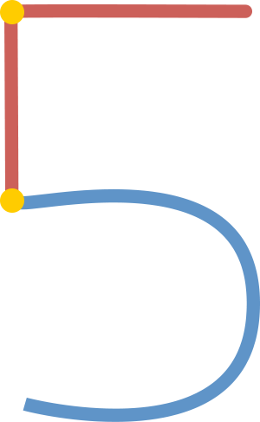
Gesture Speed Metric
Basis:
CLC Model [Cao and Zhai, 2007]
Notes:
The next metric is the gesture speed metric, which estimates the gesture typing speed of a given keyboard layout. It’s based on the CLC model by Xiang Cao and Shumin Zhai, which predicts the typing speed of gestures by breaking them up into curves, lines, and corners: CLC. The time to gesture a line segment is a power function based on its length. In our case, the word gestures are all polylines, so the time it takes to gesture the word is simply the sum of each segment’s power function.
So given a candidate keyboard layout K, the metric outputs the expected gesture typing speed on K by taking the weighted average of the time it takes to gesture each word on K. (Again, weighted by the words’ frequencies)

Slide 26
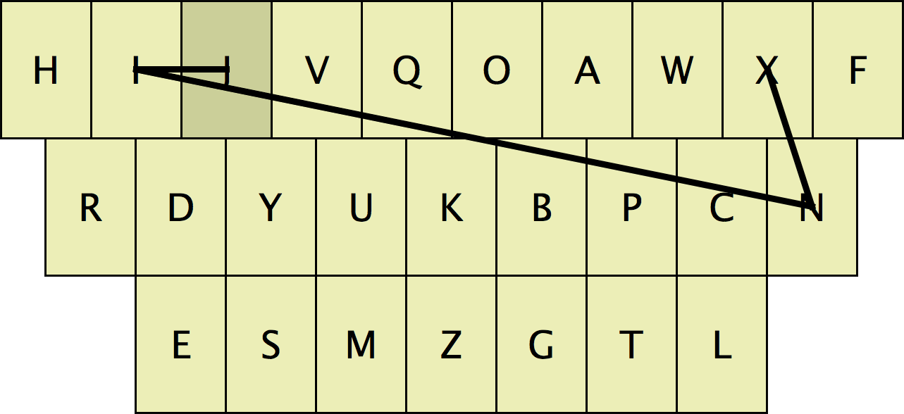
Gesture Speed Metric
Basis:
CLC Model [Cao and Zhai, 2007]
Input:
Keyboard layout K
Output:
Expected gesture typing speed on K
Notes:
The next metric is the gesture speed metric, which estimates the gesture typing speed of a given keyboard layout. It’s based on the CLC model by Xiang Cao and Shumin Zhai, which predicts the typing speed of gestures by breaking them up into curves, lines, and corners: CLC. The time to gesture a line segment is a power function based on its length. In our case, the word gestures are all polylines, so the time it takes to gesture the word is simply the sum of each segment’s power function.
So given a candidate keyboard layout K, the metric outputs the expected gesture typing speed on K by taking the weighted average of the time it takes to gesture each word on K. (Again, weighted by the words’ frequencies)

Slide 27
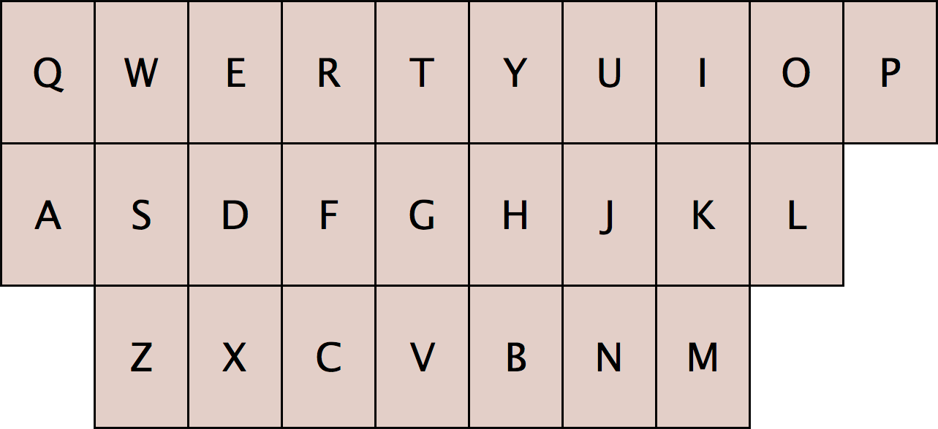
Qwerty Similarity Metric
Basis:
Manhattan distance
Input:
Keyboard layout K
Output:
Total displacement between keys’ positions on K and their positions on Qwerty
Notes:
And the last metric is the Qwerty similarity metric, which is a proxy for the learnability of a keyboard layout. Here, we use the total Manhattan distance between a keyboard layout’s keys and their Qwerty locations to see how similar the keyboard layout is the Qwerty. So, it takes a keyboard layout as input and treats it as if it’s aligned on a grid like Qwasi-Qwerty, which we saw before. Then, as output, it tallies up the row and column displacements for each key relative to Qwerty.

Slide 28
Optimization Procedure

Slide 29
Pareto Optimization
Speed
2D case shown for simplicity
Clarity
Notes:
A better approach is Pareto optimization, or more formally, Edgeworth–Pareto optimization [Francis Edgeworth, 1881 vs. Vilfredo Pareto in 1896], in which we create an optimal set of points called a Pareto optimal set that represents the tradeoffs in choosing a point at the cusp of greatness, so to speak. That set is also called a Pareto frontier or Pareto front. In our case, these points will represent keyboard layouts with metric scores for A and B, and a 3rd dimension, C. A point is Pareto-optimal (meaning it’s on the front) if and only if it’s not dominated by another point, so if there’s not another point that’s better than it in both metrics.

Slide 30
Pareto Optimization
Speed
2D case shown for simplicity
Clarity

Slide 31
Pareto Optimization
Speed
2D case shown for simplicity
Clarity

Slide 32
Heuristic Search Process
Basis:
Metropolis random walk algorithm
Initial Value:
Random keyboard layout K
Update Rule:
K´ swapTwoKeys(K )
If h (K ´ ) > h (K ):
K K ´
Else:
K K´ with probability T(t)
Notes:
Here, we do the same type of heuristic search as in Phase 1, with the exact same iterative scheme, except this time instead of using one metric as a heuristic, we use weighted combinations of the metrics as a heuristic. This is where the normalization matters so we can weight appropriately. Notice that this is that same function we saw a couple slides ago that I said “Don’t use,” only this time we remember all of the layouts we encounter and compute the Pareto optimal set after we run all the searches.

Slide 33
Heuristic Search Process
Basis:
Metropolis random walk algorithm
Speed
α₁, β₁, γ₁
α₂, β₂, γ₂
2D case shown for simplicity
α₃, β₃, γ₃
Clarity
Notes:
Here, we do the same type of heuristic search as in Phase 1, with the exact same iterative scheme, except this time instead of using one metric as a heuristic, we use weighted combinations of the metrics as a heuristic. This is where the normalization matters so we can weight appropriately. Notice that this is that same function we saw a couple slides ago that I said “Don’t use,” only this time we remember all of the layouts we encounter and compute the Pareto optimal set after we run all the searches.

Slide 34
Heuristic Search Process
Basis:
Metropolis random walk algorithm
Speed
2D case shown for simplicity
Clarity
Notes:
Here, we do the same type of heuristic search as in Phase 1, with the exact same iterative scheme, except this time instead of using one metric as a heuristic, we use weighted combinations of the metrics as a heuristic. This is where the normalization matters so we can weight appropriately. Notice that this is that same function we saw a couple slides ago that I said “Don’t use,” only this time we remember all of the layouts we encounter and compute the Pareto optimal set after we run all the searches.

Slide 35
Heuristic Search Process
Basis:
Metropolis random walk algorithm
Speed
2D case shown for simplicity
Clarity
Notes:
Here, we do the same type of heuristic search as in Phase 1, with the exact same iterative scheme, except this time instead of using one metric as a heuristic, we use weighted combinations of the metrics as a heuristic. This is where the normalization matters so we can weight appropriately. Notice that this is that same function we saw a couple slides ago that I said “Don’t use,” only this time we remember all of the layouts we encounter and compute the Pareto optimal set after we run all the searches.

Slide 36
Optimized Keyboard Layouts
Notes:
So here’s the exciting part. Care to see what the optimized keyboard layouts actually look like? (the final Pareto front)

Slide 37
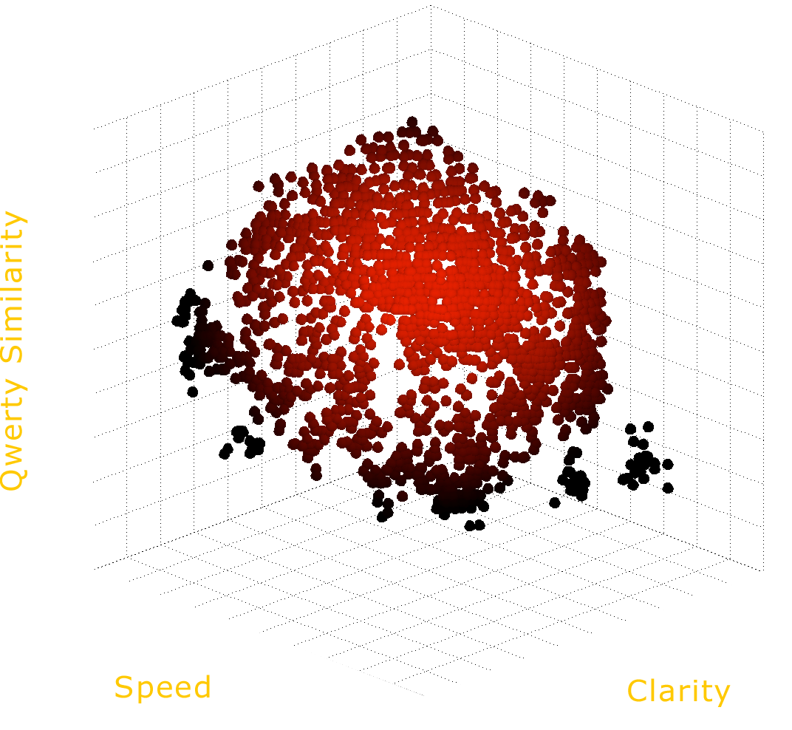
Final Pareto Front
1,725 layouts of 900,000+ encountered
Notes:
Here’s the final Pareto front of optimized layouts, in 3D. Here, the brighter points are farther from the origin. Again, I’ll emphasize that none of these keyboard layouts is unquestionably better than the others. Each is better than the others in some way, and choosing a layout on the front amounts to figuring out what your tastes are. How important is learnability to you versus speed or accuracy? The front consists of over 1,700 layouts out of over 900,000 that we encountered.

Slide 38
2D Pareto Front
Must gesture clarity and typing speed necessarily conflict?
Notes:
If we project the front onto the clarity–speed plane (the ground here) and examine the tradeoffs between just clarity and speed (independent of learnability), we’ll get this. Here, we get the answer to our first key question: whether clarity and speed are at odds with each other. The answer to that is yes, there’s almost a -45 degree line between clarity and speed. Nonetheless, we can still get clarity and speed that are much better than Qwerty. Note that these axes show the normalized scores, but here you can see how that translates to the actual metrics.

Slide 39
2D Pareto Front
Notes:
If we project the front onto the clarity–speed plane (the ground here) and examine the tradeoffs between just clarity and speed (independent of learnability), we’ll get this. Here, we get the answer to our first key question: whether clarity and speed are at odds with each other. The answer to that is yes, there’s almost a -45 degree line between clarity and speed. Nonetheless, we can still get clarity and speed that are much better than Qwerty. Note that these axes show the normalized scores, but here you can see how that translates to the actual metrics.

Slide 40
2D Pareto Front
77.9
72.5
67.0
How much clearer can gestures get?
61.5
56.1
50.6
0.256
0.311
0.367
0.422
0.477
0.533
Notes:
If we project the front onto the clarity–speed plane (the ground here) and examine the tradeoffs between just clarity and speed (independent of learnability), we’ll get this. Here, we get the answer to our first key question: whether clarity and speed are at odds with each other. The answer to that is yes, there’s almost a -45 degree line between clarity and speed. Nonetheless, we can still get clarity and speed that are much better than Qwerty. Note that these axes show the normalized scores, but here you can see how that translates to the actual metrics.
This also reveals the answer to our second question: how much clearer can gestures get? We can actually improve clarity by about 40% over Qwerty.

Slide 41
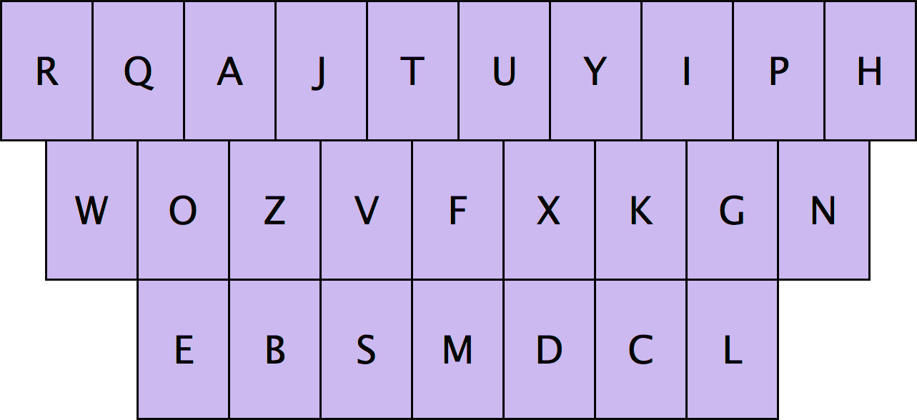
Optimized Layouts
77.9
72.5
67.0
GK-C
61.5
56.1
50.6
0.256
0.311
0.367
0.422
0.477
0.533
Notes:
But what do these layouts actually look like? The first layout is GK-C, which stands for “Gesture Keyboard—Clarity,” but it’s affectionately known as the Woz layout. This is the layout optimized for clarity at the expense of everything else. Here, common letters are arranged far apart in a radial fashion.

Slide 42
Optimized Layouts
77.9
72.5
67.0
GK-C
61.5
56.1
50.6
0.256
0.311
0.367
0.422
0.477
0.533
Notes:
But what do these layouts actually look like? The first layout is GK-C, which stands for “Gesture Keyboard—Clarity,” but it’s affectionately known as the Woz layout. This is the layout optimized for clarity at the expense of everything else. Here, common letters are arranged far apart in a radial fashion.

Slide 43
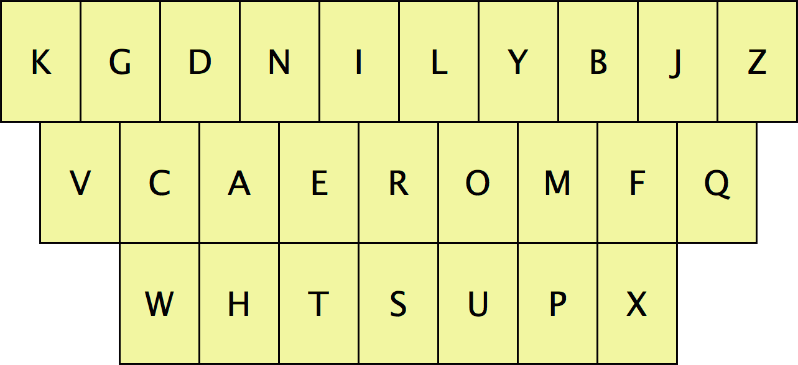
Optimized Layouts
77.9
72.5
67.0
GK-C
GK-S
61.5
56.1
50.6
0.256
0.311
0.367
0.422
0.477
0.533
Notes:
On the other end of the spectrum we have GK-S, which stands for “Gesture Keyboard—Speed,” but it’s affectionately known as the Woz layout.

Slide 44
Optimized Layouts
77.9
72.5
67.0
GK-C
GK-S
61.5
56.1
50.6
0.256
0.311
0.367
0.422
0.477
0.533
Notes:
On the other end of the spectrum we have GK-S, which stands for “Gesture Keyboard—Speed,” but it’s affectionately known as the Woz layout.

Slide 45
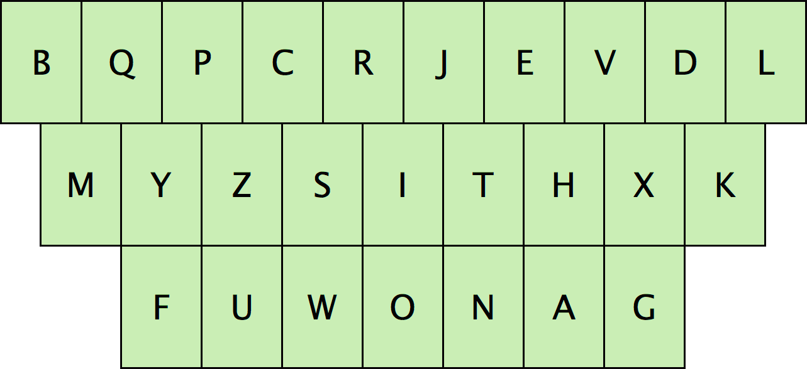
Optimized Layouts
77.9
72.5
67.0
GK-C
GK-S
61.5
56.1
50.6
0.256
0.311
0.367
0.422
0.477
0.533
GK-D
Notes:
Now let’s look at something midrange.

Slide 46
Optimized Layouts
77.9
72.5
67.0
GK-C
GK-S
61.5
56.1
50.6
0.256
0.311
0.367
0.422
0.477
0.533
GK-D
Notes:
The first layout is GK-C, which stands for “Gesture Keyboard—Clarity,” but it’s affectionately known as the Woz layout.

Slide 47
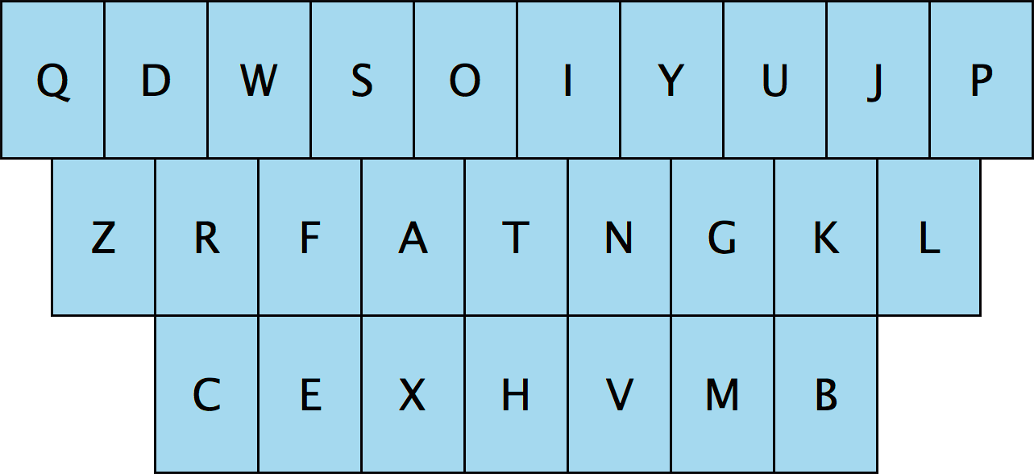
Optimized Layouts
GK-T
GK-C
GK-S
GK-D
GK-T
Notes:
And lastly, we have GK-T, which is a triple-optimized layout. This is the layout that answers our third question: How do these answers change if we keep the layout similar to Qwerty? To find this layout, we took the 3D Pareto front and chose the layout closest to the 45 degree line, right in the middle. Again, a reasonable compromise between clarity, speed, and Qwerty similarity. The result is really interesting. If you project that point back to our 2D front, you end up with this. So you don’t really need to take a hit in terms of clarity or speed to accommodate learnability as well.

Slide 48
Optimized Layouts
How will keeping the layout similar to Qwerty affect our results?
GK-C
GK-S
GK-D
GK-T
Notes:
And lastly, we have GK-T, which is a triple-optimized layout. This is the layout that answers our third question: How do these answers change if we keep the layout similar to Qwerty? To find this layout, we took the 3D Pareto front and chose the layout closest to the 45 degree line, right in the middle. Again, a reasonable compromise between clarity, speed, and Qwerty similarity. The result is really interesting. If you project that point back to our 2D front, you end up with this. So you don’t really need to take a hit in terms of clarity or speed to accommodate learnability as well.

Slide 49
Optimized Layouts
77.9
72.5
67.0
GK-C
GK-S
61.5
56.1
50.6
0.256
0.311
0.367
0.422
0.477
0.533
GK-D
GK-T
Notes:
And lastly, we have GK-T, which is a triple-optimized layout. This is the layout that answers our third question: How do these answers change if we keep the layout similar to Qwerty? To find this layout, we took the 3D Pareto front and chose the layout closest to the 45 degree line, right in the middle. Again, a reasonable compromise between clarity, speed, and Qwerty similarity. The result is really interesting. If you project that point back to our 2D front, you end up with this. So you don’t really need to take a hit in terms of clarity or speed to accommodate learnability as well.

Slide 50
Optimized Layouts
77.9
72.5
67.0
GK-C
GK-S
61.5
56.1
50.6
0.256
0.311
0.367
0.422
0.477
0.533
GK-D
GK-T
Notes:
And lastly, we have GK-T, which is a triple-optimized layout. This is the layout that answers our third question: How do these answers change if we keep the layout similar to Qwerty? To find this layout, we took the 3D Pareto front and chose the layout closest to the 45 degree line, right in the middle. Again, a reasonable compromise between clarity, speed, and Qwerty similarity. The result is really interesting. If you project that point back to our 2D front, you end up with this. So you don’t really need to take a hit in terms of clarity or speed to accommodate learnability as well.

Slide 51
Real-World Performance

Slide 52
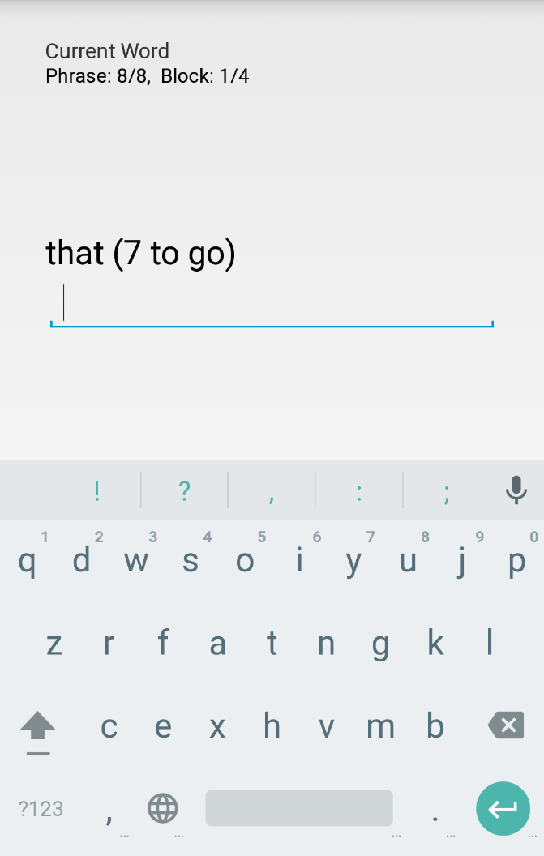
Error Rate By Repetition
Qwerty
GK-D
GK-T
Notes:
First we’ll look at typing error rate, since that’s the real-world manifestation of gesture clarity. To get this, we had users gesture a representative set of words with each layout as quickly as possible while ignoring all errors. They had to gesture each word in succession 7 times, as you can see here. What’s interesting here is that keyboards optimized with clarity as a component are more accurate than Qwerty. GK-D, the double-optimized one (clarity and speed), had less than half the error rate than Qwerty. For GK-T, which includes learnability as well, it was 37% less than Qwerty.

Slide 53
Gesture Entry Time By Repetition
Qwerty
GK-D
GK-T
Notes:
Lastly, if we zoom back out to see the whole graph, we’ll find something that we weren’t expecting. Namely, that incorporating Qwerty similarity as we do in GK-T does not significantly help the initial gesture entry time. This could be for several different reasons. One is that we conducted our study in a single session. We didn’t have users use the keyboard for several weeks or months to see how the long-term learnability pathway actually plays out. Another reason is the metric that we used to represent learnability. We used Manhattan distance, which is relatively lenient. Other keyboard optimizations have used squared distance, and still others (like Quasi-Qwerty) used a strict threshold, but there’s never been a study of what works and what doesn’t. A really promising area for future work would be to investigate the actual relationship between perturbations in a keyboard layout and its resulting learnability falloff, and define what it means for a keyboard layout to be easy to learn. You can think of the metrics that we proposed — clarity, speed, and Qwerty similarity — to be a first take at representing error rate, typing speed, and learnability.

Slide 54
Gesture Entry Time By Repetition
Qwerty
GK-D
GK-T
Notes:
So that was clarity. What about speed? This is how long on average it took users to gesture words. Here, you can see that the first repetition or two take the longest since users have to plan out their gestures (especially with the new layouts). As they repeat the same word over and over, their behavior is mostly governed by motor control ability, crudely representing expert input behavior. Although Qwerty is much faster for the initial gesture, if we zoom in on the latter repetitions we see a much different story.

Slide 55
Gesture Entry Time By Repetition
Qwerty
GK-D
GK-T
Notes:
It’s important to pay attention to the error bars here, but on average the gesture entry times for the optimized keyboards are about 10% quicker than on Qwerty. There isn’t a significant difference between the double- and triple-optimized layouts, though, which means that taking Qwerty similarity into account doesn’t really hurt the typing speed.

Slide 56
Summary
77.9
72.5
67.0
61.5
56.1
50.6
0.256
0.311
0.367
0.422
0.477
0.533
GK-D
GK-T
Notes:
So what have we done? We’ve defined an optimization space for gesture typing and computationally explored that space. In the process, we discovered that optimizing for gesture clarity dramatically improves gesture typing accuracy, and that clarity and speed conflict with each other even though you can still do much better than Qwerty. We’ve discovered a set of optimized layouts that can immediately benefit mobile device users, making touchscreen typing faster and more accurate than ever. Thank you very much for listening – I’ll be happy to take any questions.

